Slide 1
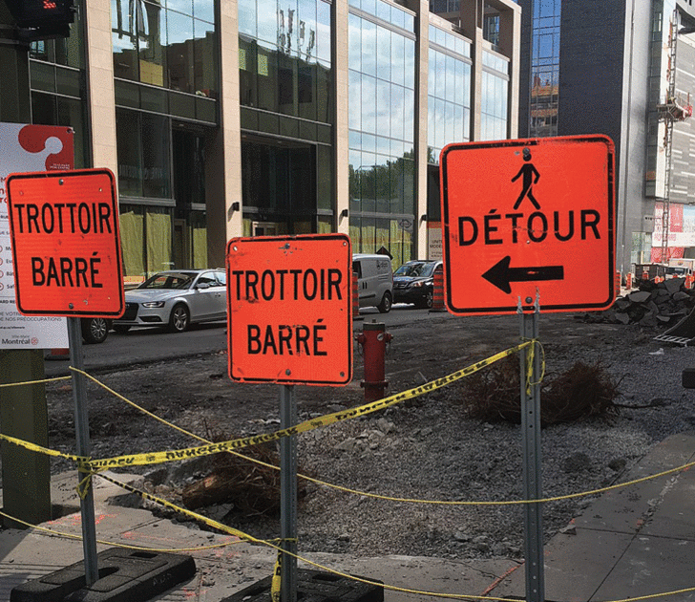
Road Distress Detection App

Slide 2
Problem Specifics
226 hours to monitor the roads once
It costs 810000$ and 33000 hours per year only for potholes detection
Canada spends 1.4 Billion$/Year
Montreal spends 2.5 million$/Year
It costs Montreal 26K$ for repairing 1 km

Slide 3
Our Idea
What if we let:
Citizens, surveillance cameras and buses take photos
And send all the photos to a server
And we use artificial intelligence to detect fissures
And map out their level of severities

Slide 4
Use cases
Save costs to the city of Montreal
Help the city determine the budget
Allow drivers to avoid streets with severe cracks

Slide 5
Architecture
Street images at certain GPS points
AI model to detect fissures
Map displaying fissures locations and their severity

Slide 6
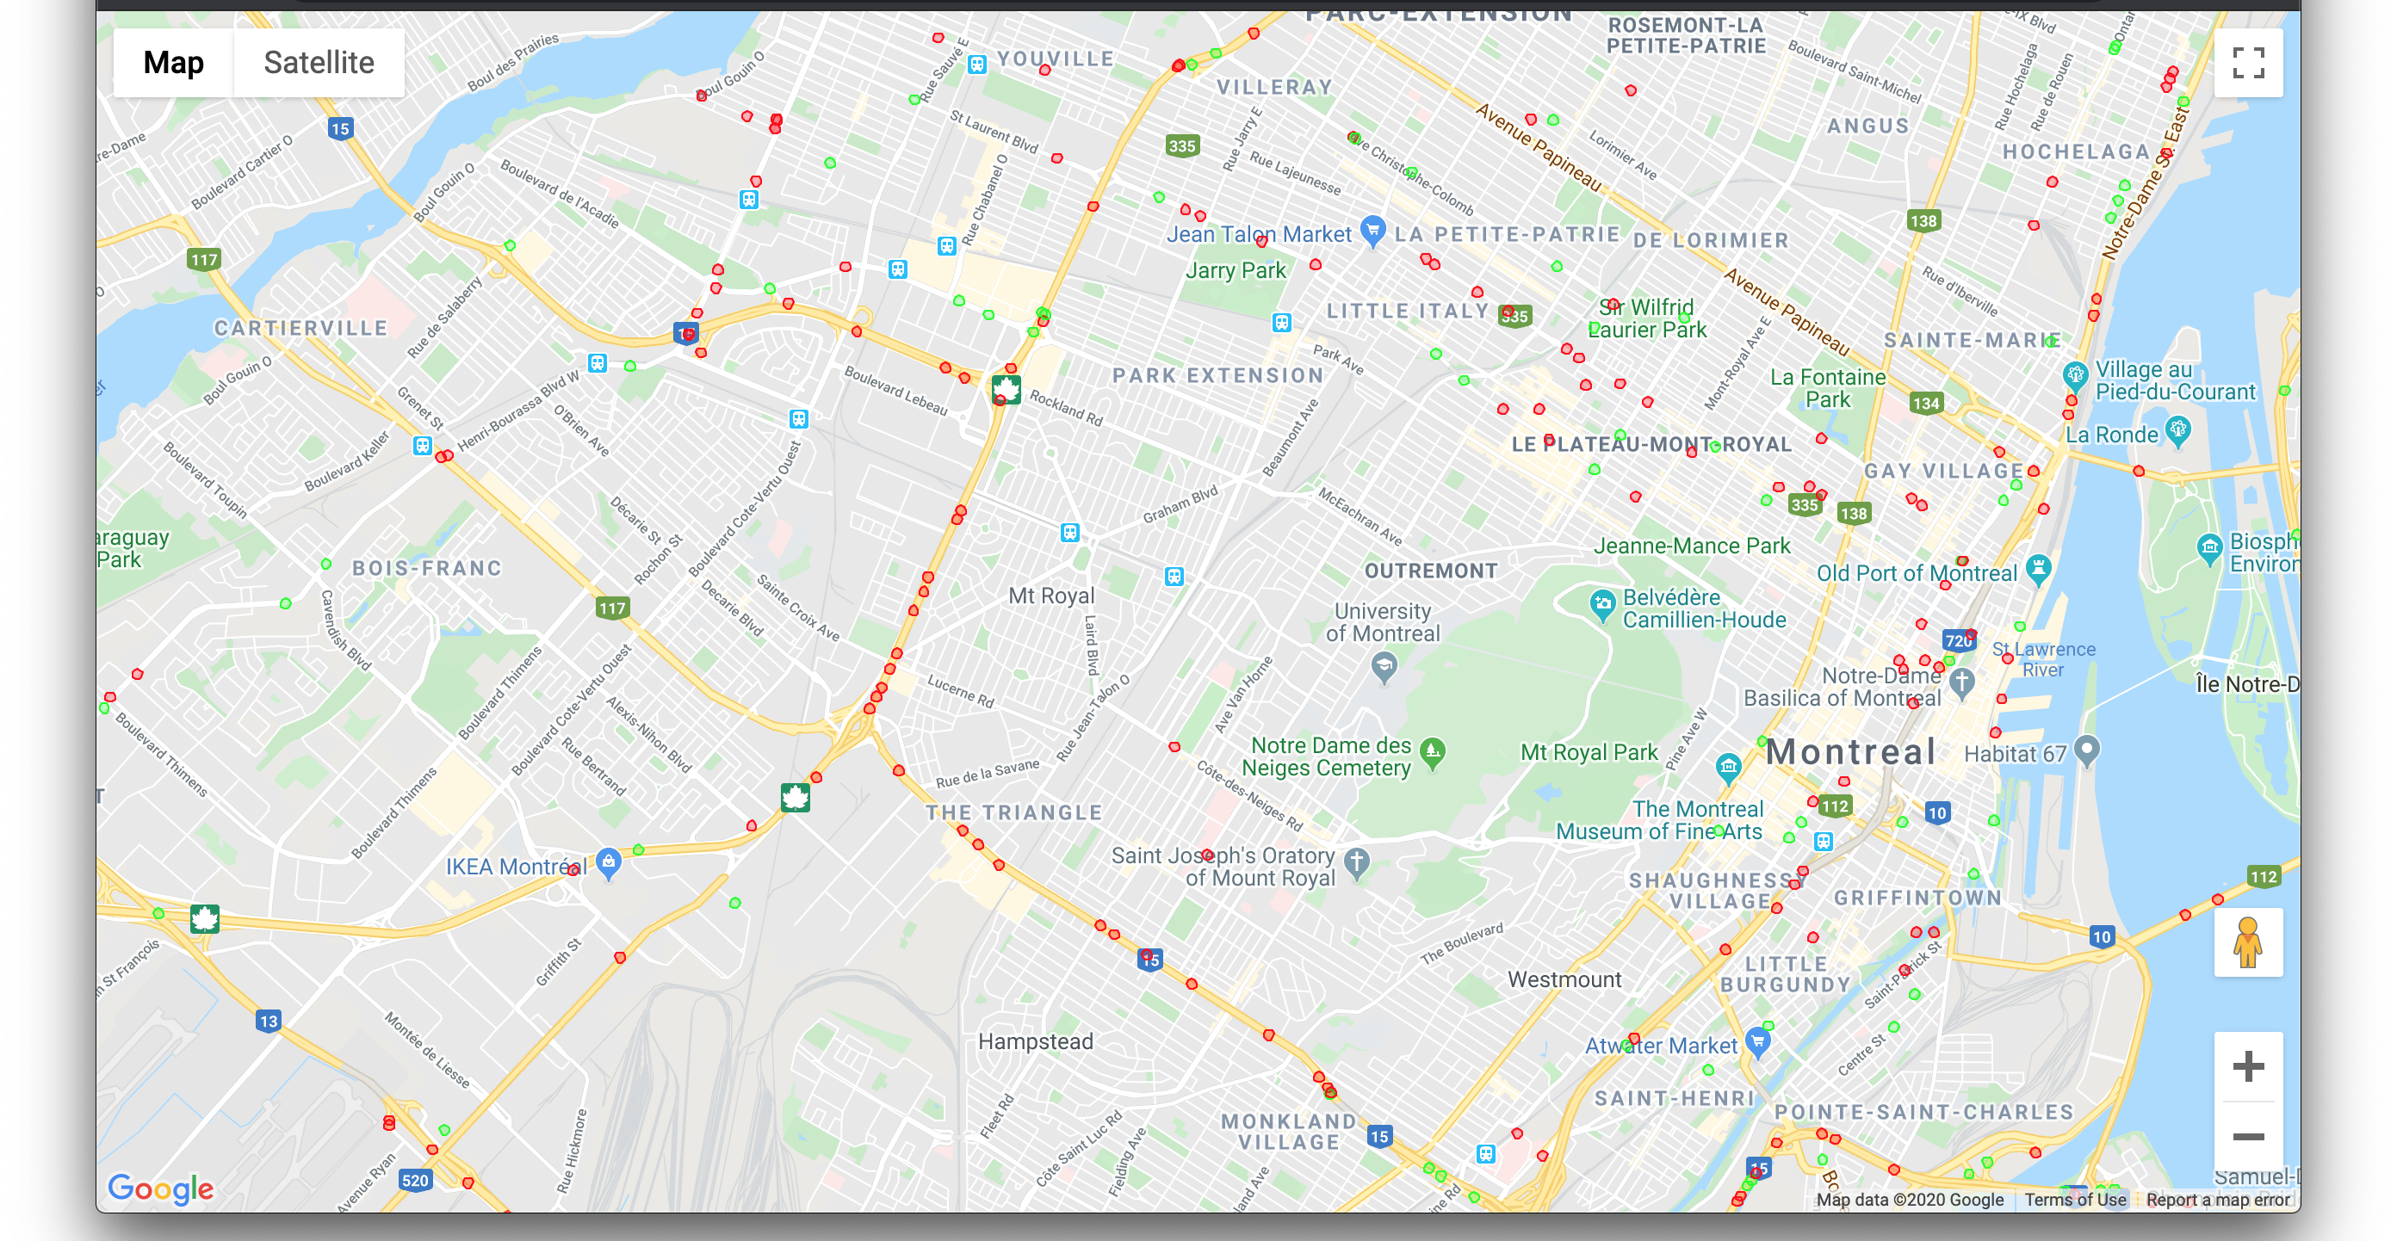

Slide 7





Platforms used

Slide 8
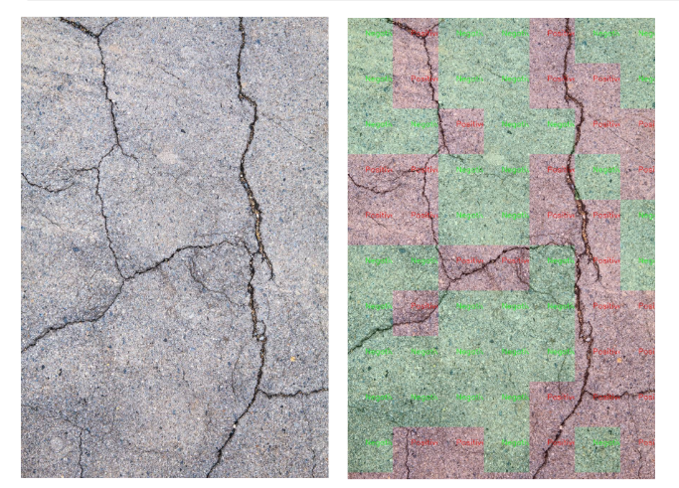
Artificial Intelligence model
A deep learning model, Resnet50 which uses transfer learning was used to detect the fissures
It was trained on more than 20 000 road images
We reached an accuracy of 97%, with 80% of the images as training and 20% as testing

Slide 9
Possible future work
Develop a user friendly app for fissure detection
Place cameras under buses
Access street cameras for early cracks detection

Slide 10
References
https://www.theglobeandmail.com/drive/mobility/article-canadas-pothole-scourge-we-get-what-we-pay-for/
https://www.cbc.ca/news/canada/montreal/city-spends-2-5-million-a-year-on-pothole-repairs-1.1307896
https://montrealgazette.com/news/local-news/montreal-budget-fewer-kilometres-of-roads-slated-to-be-redone-next-year
https://montrealgazette.com/news/local-news/the-high-cost-of-congestion-to-montreals-economy
https://github.com/priya-dwivedi/Deep-Learning/tree/master/crack_detection
https://www.researchgate.net/publication/326676263_Performance_Comparison_of_Pretrained_Convolutional_Neural_Networks_on_Crack_Detection_in_Buildings

